Slide 1
Roadpost Satellite Communications
Business Solutions

Slide 2
Agenda
Company overview
Iridium
  Iridium Extreme
  Iridium Push-to-Talk (PTT)
  Iridium GO!
Business Continuity/Disaster Recovery Solutions
inReach
Work Alone Safety Solutions
  GeoPro
  inReach Enterprise

Slide 3
Company Overview
About Roadpost
Foremost provider of mobile satellite equipment data services since 1991
Industry leading partnerships
  Iridium (Tier 1), Inmarsat, Garmin
  Extensive North American dealer network
24/7 access to technical support and knowledgebase
Over 40,000 very satisfied subscribers

Slide 4


Iridium Coverage
The only truly global satellite voice and data solutions on the planet.
66 low-earth orbiting (LEO) satellites
Iridium NEXT constellation currently launched
  State-of-the-art capabilities
  Designed to accommodate evolving technologies

Slide 5
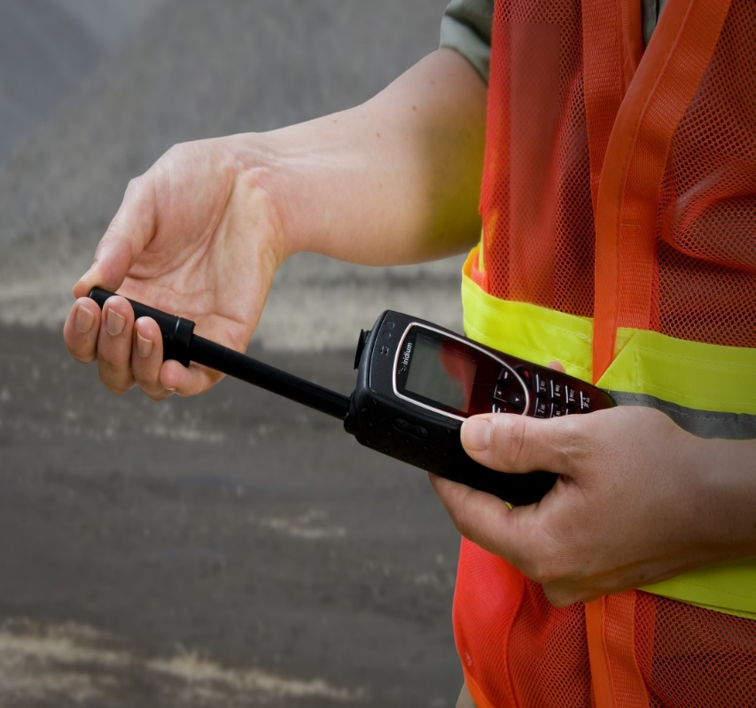
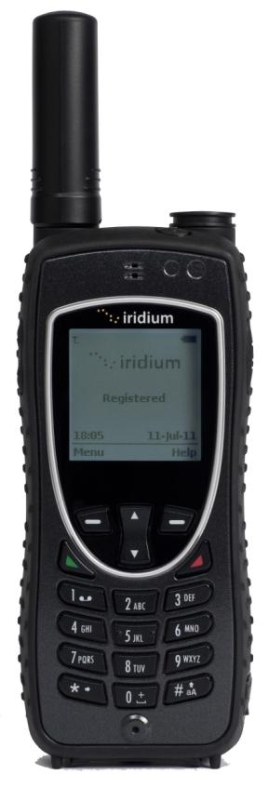
Iridium Extreme
The First Military-Grade Phone Available to the Consumer Market
Highest IP rated phone.
Offers the best connections even under harsh conditions.

Slide 6
Iridium Extreme Specs
Size (including antenna) | 140 mm x 60 mm x 27 mm
Weight | 247 g
Impact-Resistant | Mil-STD-810F
Operating Temperature | -10 degrees C to +55 degrees C
Ingress Protection (IP) Rating | IP65 (dust and blowing rain)
Battery Life | 4 hours talk time
GPS Fix | Latitude, longitude, altitude, age of fix, number of satellites
Communication | Voice and text; keypad entry
SOS | Covered SOS button; can be cancelled

Slide 7

Iridium Extreme Features
Dedicated programmable SOS button
Location-aware integrated GPS
Most compact
10% thinner and 7% lighter than the 9555
Military-grade resistance to dust, shock, vibration and blowing rain
Call timers to manage costs
PIN lock for added security

Slide 8
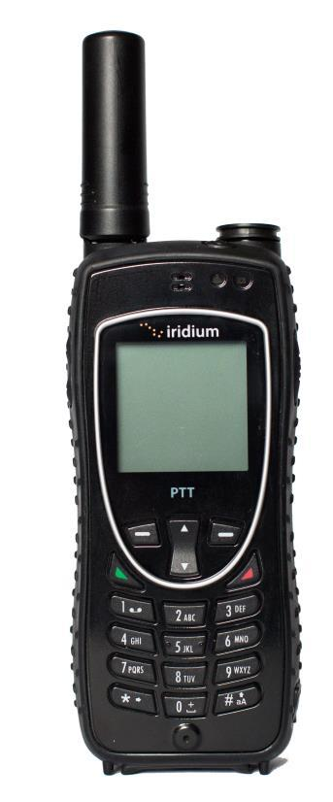

Iridium Push-to-talk (PTT)
Low-Latency, Secure Group Communication at the Push of a Button

Slide 9
Iridium Push-to-talk (PTT)
Geographic Reach
  Anywhere on Earth
  Up to 10 different regions covered by talkgroup
Low Latency
  Less than 2 seconds from button push to talking
  Less than 500ms once in a call
Telephony and PTT
  Either type of communication is supported
  Depends on device implementation
Unlimited Authorized Participants
  May provision an unlimited number of devices into each talkgroup (>10,000 devices)

Slide 10
Iridium Push-to-talk (PTT)
Secure Communications
  Encryption using AES-256
  Devices assigned keys to control provisioning of talkgroups and other attributes
  Talkgroups assigned keys to ensure that each talkgroup is a closed user group

Slide 11
Iridium Push-to-talk (PTT)
Centralized Controls
  All service coordination is performed using a single interface
  End user organizations may control their own service and device parameters
  Talkgroup areas can be changed in seconds
  Device membership changes effective within seconds
Device Controls
  Devices may be disabled, network suspended or billing suspended within seconds
Simple Geographic Interface
  Google maps utilized in geo displays
  Easy drag-and-drop controls

Slide 12
Iridium Push-to-talk (PTT)
Talkgroups
  Talker and talkgroup names are assigned within the Command Center
  Each device may be a member of up to 15 talkgroups
  Each device is informed of activities on all talkgroups to which it is a member
Priority Talkgroup
  Each device may be assigned a priority talkgroup that pre-empts all other traffic when active
Global Provisioning
  Device provisioning updates are applied anywhere on the planet regardless of talkgroup areas

Slide 13
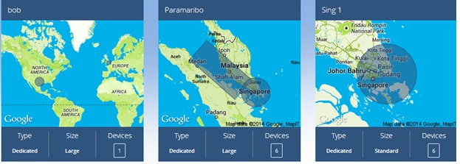
Iridium Push-to-talk (PTT)
PTT Command Center
Easily manage talkgroups and devices with a drag-and-drop interface
Name talkgroups and devices
Define geographic location for each talkgroup as a circle, square or rectangle
Drag and drop devices into talkgroups (15 max./device)

Slide 14
Iridium Push-to-talk (PTT)
Dual-mode device supports both the current capabilities (Voice, CSD, SMS, SBD, LBS) and PTT
  High quality speaker
  Dedicated PTT button
SIM-based Telephony / IMEI based Push To Talk (PTT)
  Transition from phone to PTT in 10 seconds
  Transition from PTT to phone in 20 seconds
  In PTT mode, user provided with 40 second talk spurt
  Phone calls received in PTT mode automatically go to voicemail
  In phone mode, there is no indication of PTT activity

Slide 15
Iridium Push-to-talk (PTT)
Modes
Home Mode
Device looks for communication on a specific talkgroup and participates in any sessions that are started on that group
User selects Home talkgroup from the list of talkgroups they are provisioned for and can change the Home talkgroup as often as they wish
User may switch to Scan mode to listen for active talkgroups, and switch from Scan to Home mode when the desired talkgroup is being played
Scan Mode
Device looks for activity on any of the talkgroups for which the device is provisioned and plays audio for a few seconds for each talkgroup in succession.
Can be configured to play 5- 10- or 15-second samples
A tone sounds when the talkgroup being listened to changes

Slide 16
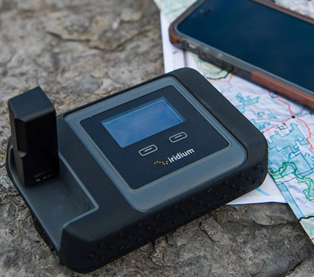
Iridium GO!
Wi-Fi hotspot for up to five smartphone users
Jet water resistant, shock resistant and dust proof
Works with the Iridium GO! app and Mail and Web app
No roaming charges
GPS positioning
Programmable SOS button
Online tracking
3rd party apps available
Global Voice, Text Messaging and Data Access for Up to Five (5) Users. Just Flip the Antenna and GO!

Slide 17
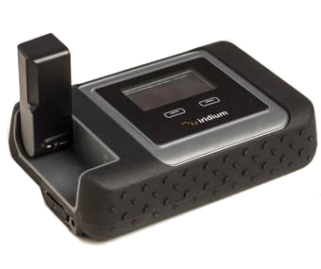
Iridium GO!
Size | 81.7 X 119.81 X 33.44 mm
Weight w/ battery | 305 g
Temp. Ranges | -10C to +50C (Operational) -20C to +60C (Storage)
Wi-Fi Frequency & Range | up to 30.5 meters (2.4 Ghz b, g, n)
# of Users | Up to 5
Battery Life | up to 5.5 hrs talk time / up to 15.5 standby
Battery Charge Time | 4 hours
Interface Connectors | SIM, micro USB, External Antenna
External Antenna Adapter | TS-9 (TS-9 to TNC adapter available)

Slide 18

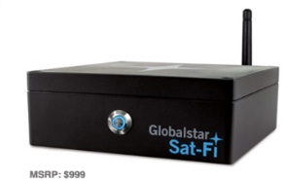
Compare Wi-Fi Hotspot Devices
Network & Coverage | Iridium GO! 100% global, no gaps | Globalstar Sat-Fi US and Southern Canada
Setup/Installation | Easy, under 30 seconds | Manufacturer recommends professional installation
Applications | Voice calls, Email Light mobile-friendly web browsing GPS Positioning Photo transfer/attachments Weather, Social media, SMS SOS button, Tracking | Voice calls, Email Light mobile-friendly web browsing GPS Positioning Photo transfer/attachments Weather, Social media
Mobility | Works stationary or on the move | In-vehicle, requires connectivity to power source
Data speeds | 9.6 kbps with Web & Mail app | Up to 9.6 Kbps
Multi-user | 1-5 (1 in use) | 1-8 (1 in use)
Voice Quality | High, cellular-like | High
IP rating | IP65 | IP4
GPS Accuracy | 2.5 m | Unknown
SOS button | Yes, includes GEOS emergency monitoring | No

Slide 19




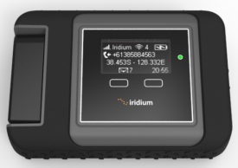

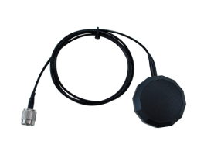

Iridium GO! Usage Scenarios
1
Portable
2
In-Vehicle
3
In-Building

Slide 20
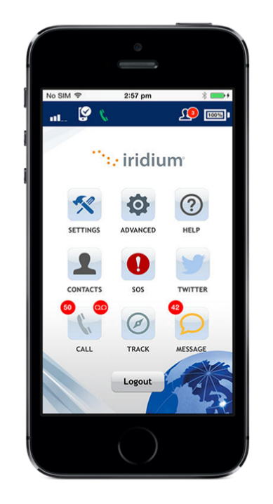
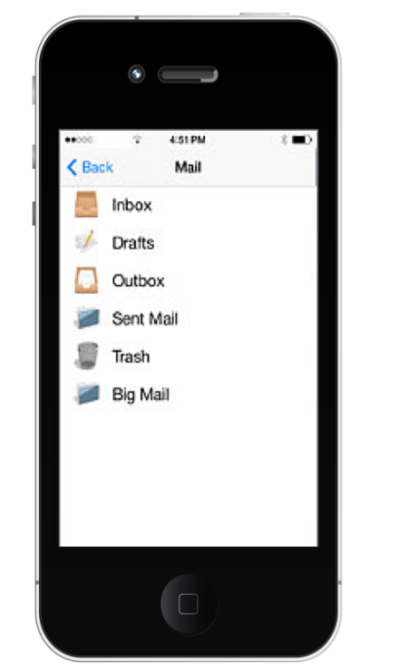


Iridium GO!
Available in iTunes and Google Play and are Required to Connect to Your Iridium GO!
Iridium GO! App | Iridium GO! Mail & Web App
Apple iOS and Android Multiple Users (up to 5) Settings Phone calling & transfer Text messaging SOS button Tracking Twitter Contact Management In-App Help | Apple iOS and Android E-mail: <name>@my.iridium.net External account sync Compression Mobile web browsing Photo transfer Social media updates Weather In-App Help

Slide 21
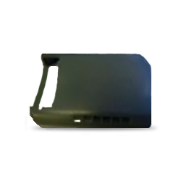
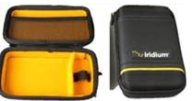
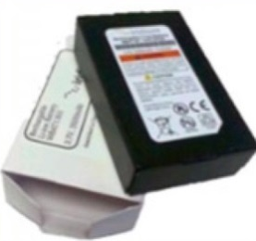

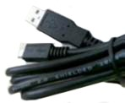

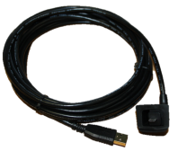
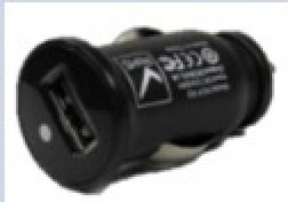

Iridium GO!
Included Accessories:
Optional Accessories:
Carry Bag with carabiner
Protective
Cover
Battery
AC Adapter Kit
Wall Mount
USB Cable
5m Outdoor USB Cable
DC Auto Adapter
External Antenna Adapter

Slide 22

Business Continuity & Disaster Recovery Solutions (BC/DR)
Satellite networks are not vulnerable to land-based events like natural disasters which can knock out traditional landline or cellular communications.
Satcoms offers reliable back up communications during and after a natural disaster or catastrophic event.

Slide 23
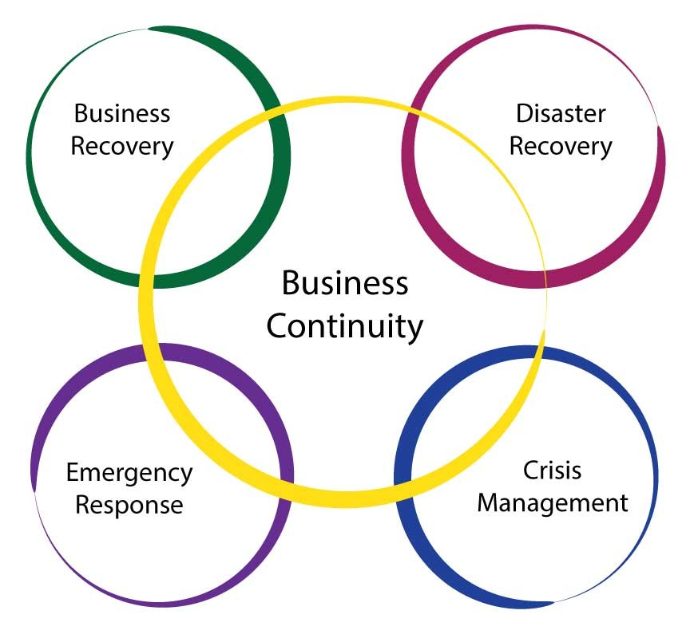
BC/DR Communication Solutions
The Importance of Business Continuity and Disaster Recovery Planning
56% of IT decision makers in the U.S. and Europe view upgrading disaster recovery (DR) capabilities as a major priority*
40% of small businesses do not reopen after a disaster**
25% fail within one year**
*Data source: https://www.chamber101.com/2programs_committee/natural_disasters/disasterpreparedness/Forty.htm
**Data source: https://www.chamber101.com/2programs_committee/natural_disasters/disasterpreparedness/Forty.htm

Slide 24
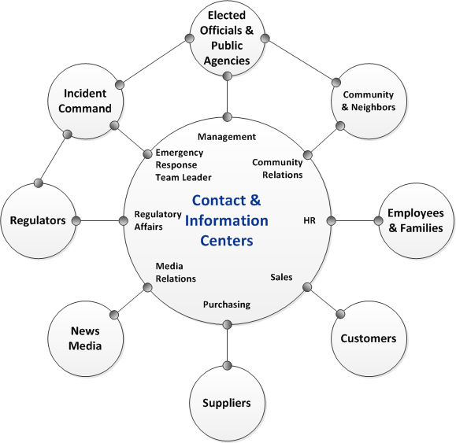
BC/DR Communication Solutions
A Satellite Communication Backup Ensures Key Personnel Can Communicate If:
Internal systems are down
Local infrastructure is damaged by extreme weather, natural disasters, or geo-political events
  Cell towers
  Phone lines
  Internet connections
Image source: https://www.ready.gov/business/implementation/crisis

Slide 25



BC/DR Communication Solutions
1
In-hand
2
In-vehicle
3
In-building
Iridium Extreme
Iridium Extreme Grab and Go Kit
Iridium GO!
Iridium GO! On the Go Kit
Iridium Extreme DriveDOCK
Iridium 9555 satellite phone used with SatDOCK 9555
Iridium Extreme + PotsDOCK Extreme
Iridium RST-100 RemoteSAT + Intelligent Iridium handset or Panasonic POTS/RJ11 handset

Slide 26
BC/DR Communication Solutions
Portable In-Hand Solutions
Iridium Extreme
Portable voice and data services handset
Location aware (built in GPS chip)
Programmable SOS button and 24/7 emergency monitoring
Compatible docks enable use in-building or in-vehicle

Slide 27
BC/DR Communication Solutions
Portable In-Hand Solutions
Iridium GO! Satellite Wi-Fi Hotspot
Supports 1-5 smartphone users
Offers voice capabilities using your smartphone to make calls over the satellite network
Low-bandwidth text-based email capabilities
100% global coverage via the Iridium satellite network
Location aware (built-in GPS chip)
Programmable SOS button and 24/7 emergency monitoring

Slide 28
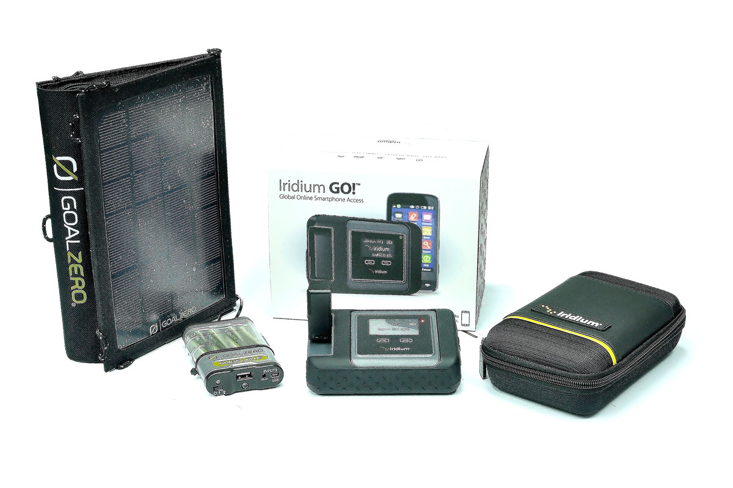
BC/DR Communications Solutions
Portable In-Hand Solutions
Iridium GO! on the Go Kit
Portable and designed for use while on-the-go
Use in settings without service
Includes Iridium GO! Complete Kit, Iridium GO! Carry Bag with Carabiner, Iridium GO! Spare Rechargeable Battery and Goal Zero Guide 10 Plus Adventure Kit

Slide 29
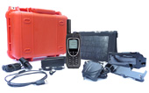
BC/DR Communication Solutions
Portable In-Hand Solutions
Iridium Grab N’ Go Kit
Everything you need to use Iridium 9555 while on the go.
Includes:
  Spare lithium ion battery
  Nomad 13 solar panel
  Pelican 1400 carry case (bright orange)
  Grab N’ Go Kit Quick Start Guide

Slide 30
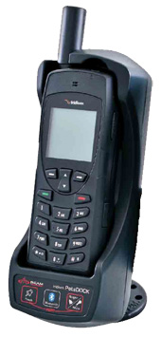
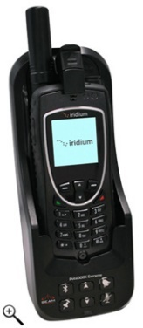
BC/DR Communication Solutions
In-Building Solutions that Work with Your Existing PBX (private branch exchange)
Use fixed in-building or remove the handset for use on-the-go
Pick up any regular phone and press a dedicated key to get a satellite line
Enables standard corded, cordless or DECT handset connections
Can function with the organizations PABX to enable standard busy, ring and dial tones
Click-to-lock mechanism for easy insertion or removal
The most competitively priced RJ11/POTS interface
Iridium 9555 satellite phone and PotsDOCK 9555
Iridium Extreme satellite phone and PotsDOCK Extreme

Slide 31
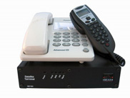
BC/DR Communication Solutions
In-Building Solutions that Work with Your Existing PABX (cont’d)
Iridium RST-100 RemoteSAT
Permanent back-up solution for use in a building or mobile command center
RJ11/POTS (plain old telephone system) interface allows the use of standard or cordless phones
Includes Iridium transceiver
Can be easily integrated with a PBX system
Emulates the ring tone you’re used to
Supports use of standard telephone equipment
Optional Intelligent Iridium handset or Panasonic POTS/RJ11 handset

Slide 32
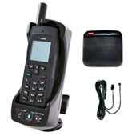
BC/DR Communication Solutions
In-Vehicle Solutions
Iridium Extreme satellite phone and DriveDOCK Extreme
Docking solution that keeps Iridium Extreme charged and ready for hands-free use
Use in-vehicle or as part of a mobile command center
Allows use of the SOS emergency button and ear-piece while docked
Handset can be removed for use outside of the vehicle
Optional privacy handset
Optional Intelligent Privacy Handset replicates the full functionality of the Iridium Extreme away from the vehicle

Slide 33


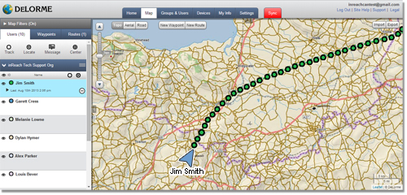
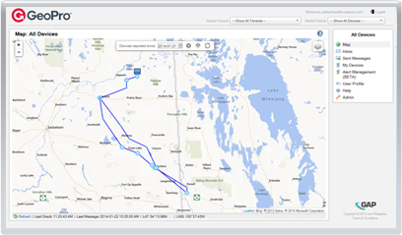
Work Alone Safety Monitoring Solutions
Lone Worker Safety Devices and Monitoring Apps

Slide 34
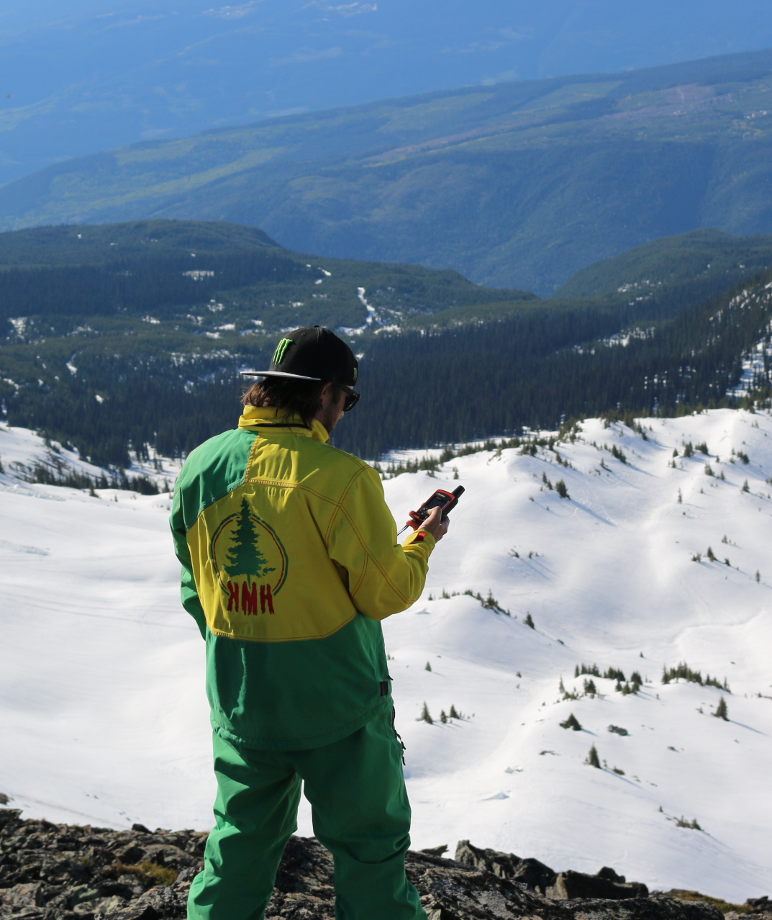
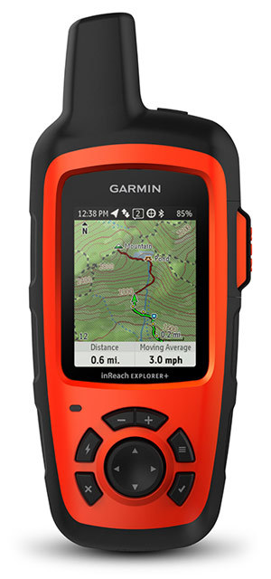
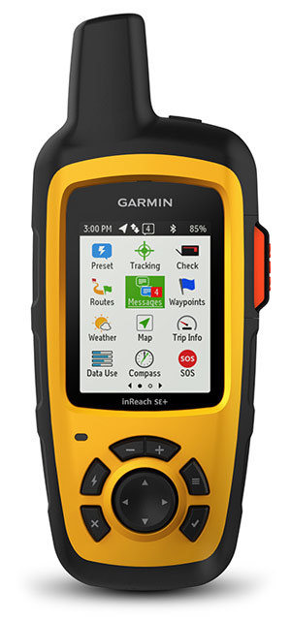
inReach Lone Worker Safety Devices
inReach: Two-way messaging with GPS and SOS -- anywhere in the world!

Slide 35
inReach
Applications
Compliance with Work Alone Safety legislation
Emergency Response & Search and Rescue
Asset tracking, remote tracking and trail-mapping
Flight tracking and messaging for aviation
Route tracking and messaging for marine applications

Slide 36

inReach
2-way Messaging
  Send and receive 160 character free-form SMS and email messages
  View and respond to incoming messages directly on screen or with a paired device
  Receive delivery confirmation through audible alerts, visual cues and blinking lights

Slide 37


inReach
SOS Button
  Trigger an SOS from anywhere in the world
  Automatic GPS location tracking
  GEOS or customizable SOS routing
Tracking
  Turn tracking on to share: GPS coordinates, course, speed & elevation in real-time
  Configurable intervals from every 30 seconds to 4 hours (Enterprise app)*
*Minimum interval is 10 minutes using Standard app

Slide 38
inReach SE+ Features
Size (incl. antenna) | 164 mm x 68 mm x 38 mm
Weight | 213 g
Impact-Resistant | Mil-STD-810F
Operating Temp. | -20° C to +60° C
Ingress Protection (IP) Rating | IPX7 Dust tight & waterproof; (to 1 m for 30 min)
Battery | Internal lithium polymer
Battery Life | 100 hours (tracking every 10 minutes)
GPS Fix | +/- 5 m (lat, long, altitude, speed, direction)
Communication | 2-way text; virtual keyboard with predictive text
SOS | SOS button lock; cancellable

Slide 39
inReach Explorer+ Features
All the Features of the inReach SE+, Plus Navigation:
Plan routes online before taking a trip and share them with family and friends
Easy-to-follow, color-coded map view displays route, waypoints, tracks and messages geo-located onscreen for backtracking or self-rescue
Create or view waypoints to mark key locations, such as camp, trailhead, truck, etc., and then navigate to them.
Built-in digital compass provides heading and bearing information even when standing still
Built-in barometric altimeter and accelerometer provide accurate elevation, speed, and moving average

Slide 40
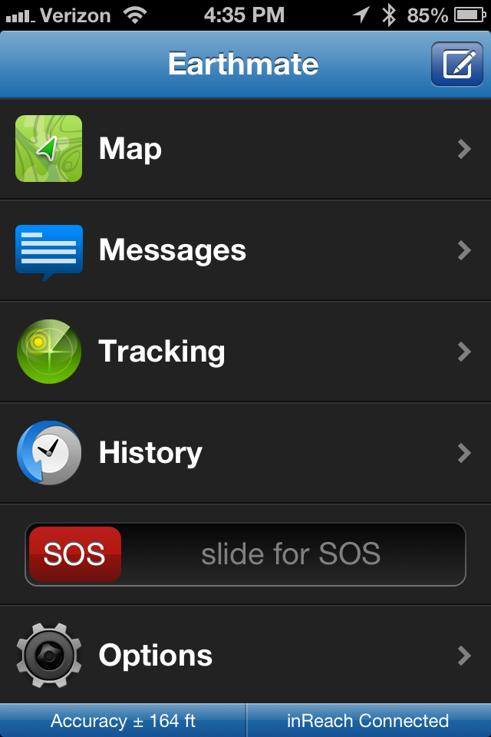
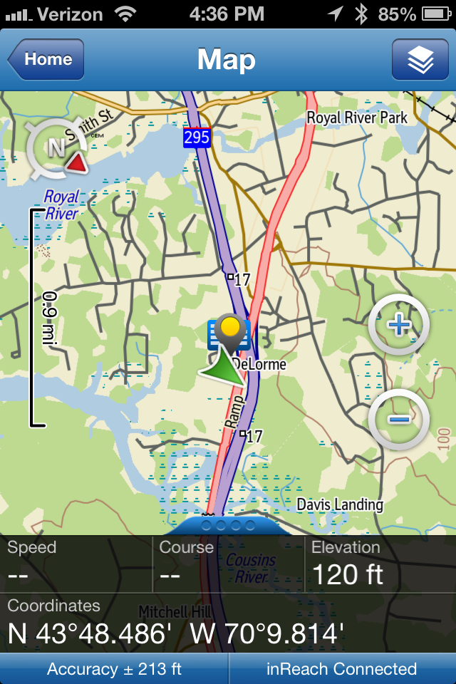
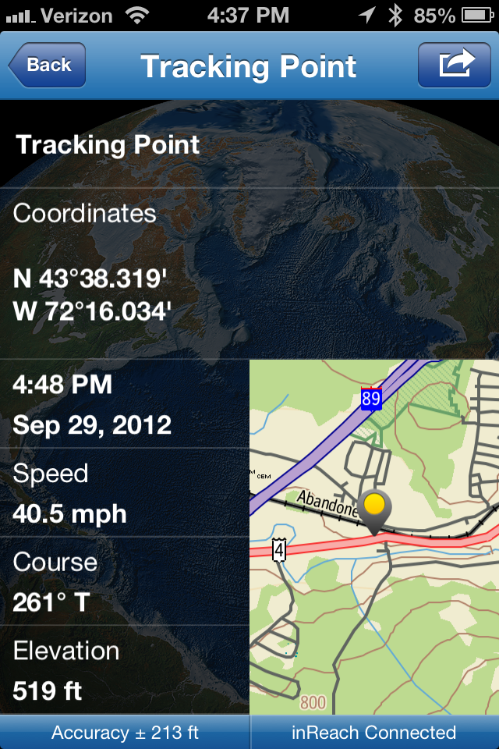
Earthmate App (for Smartphones)
Turn a smartphone or tablet into a global satellite communications and navigation tool by downloading the Earthmate app and pairing inReach with it

Slide 41
inReach Enterprise Web App
Features
Manage Multiple inReach Device Users
Convenient ‘list’ view for easier monitoring and management of larger numbers of inReach users.
Powerful Tracking
Tracking intervals as frequent as every 30 seconds; ideal for use in-vehicle or in-cockpit.
Application Programming Interface (API)
Makes it easy for developers to export data in real time to another system, database or customized map.

Slide 42
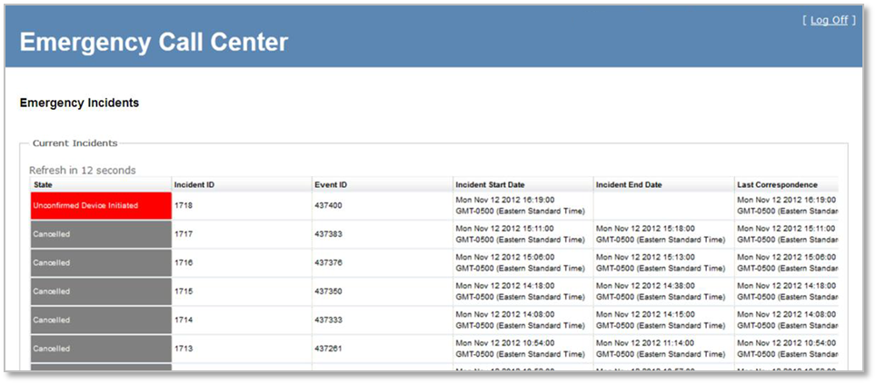
inReach Enterprise Web App
ECC Tool (optional)
Route SOS alerts to GEOS or use the included Emergency Call Centre (ECC) tool to manage incidents directly:
Route SOS alerts to up to 20 email addresses or SMS numbers
Communicate with the person in distress
Track their location on a web-based map
Maintain a detailed incident log
Display tracking data in 3D using a KML feed and Google Earth to view a detailed breadcrumb trail of the last seven days of the user’s data

Slide 43

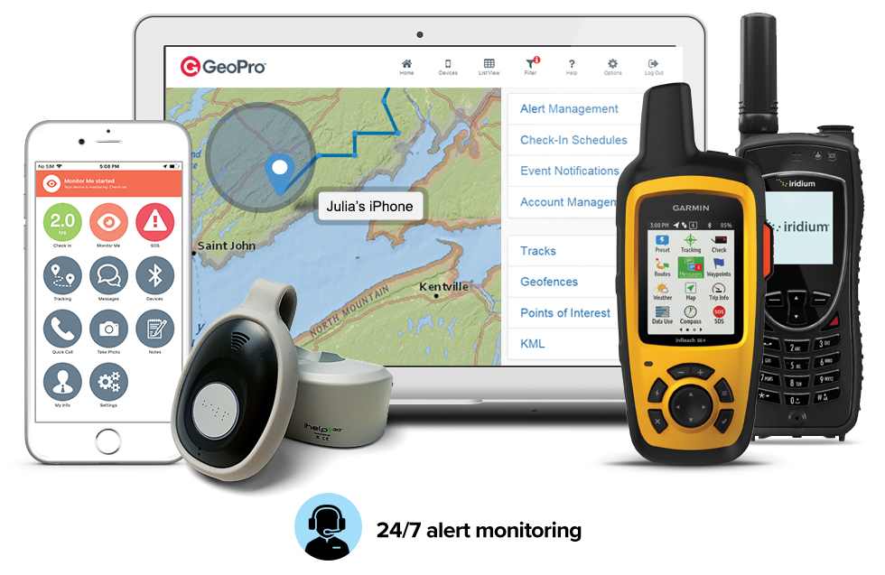
GeoPro: A Complete Work Alone Safety Solution
Highlights:
Devices and wearables to address various risk profiles
A turnkey solution for employee check-in, SOS alerting and monitoring well-being, globally
Safeguards employees with a choice of device
Automates check-in monitoring/reminders
Real-time alerting and centralized management of many safety events (not just SOS)
24/7 alert monitoring and emergency dispatch via GEOS or in-house personnel
Secure, fully hosted, easily deployed and adapted to your practices
Comprehensive incident logs and reports
API offered for integration with other systems

Slide 44

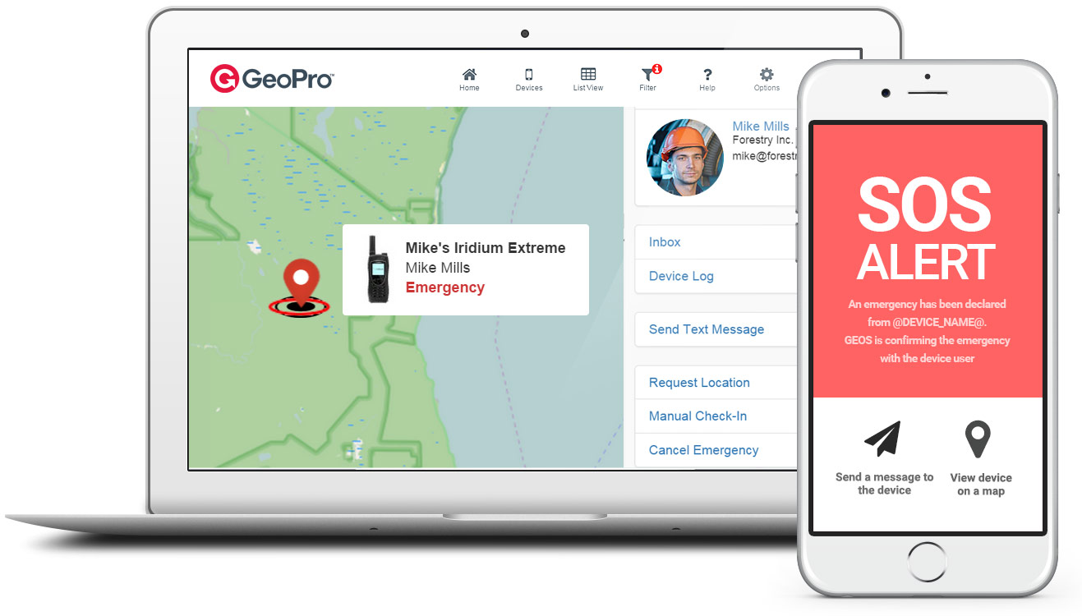





GeoPro: Centralize Alert Management
Decide what you want to monitor, let GeoPro take care of the rest
SOS Check-in Overdue check-in Journey monitoring/tracking Man down (no motion) Crossed geofence

Slide 45
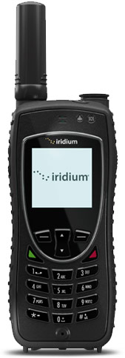
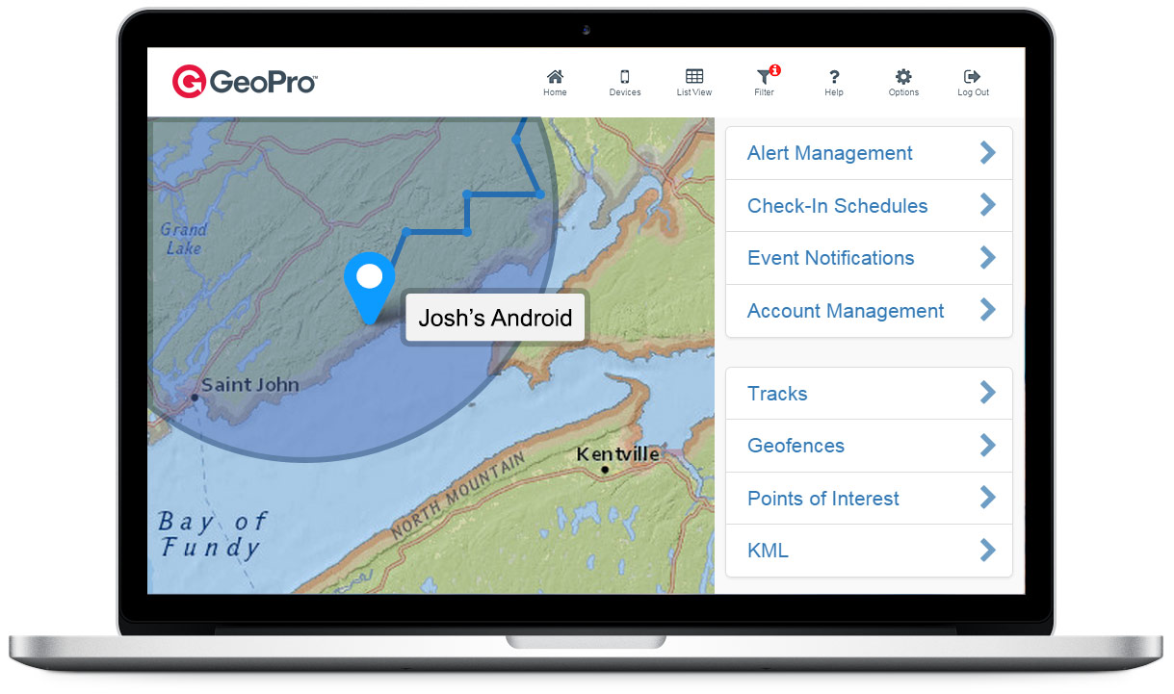
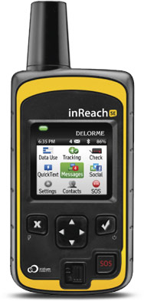

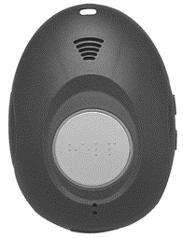
GeoPro: Lone Worker Safety Devices and Apps
Compatible lone worker devices safeguard employees working at any job site—around the corner or around the world.
Iridium Extreme
inReach SE
GeoPro Mobile App
GeoPro Safety Wearable

Slide 46
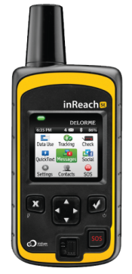


GeoPro: inReach SE Features
For job sites with no reliable landline or cellular coverage, inReach SE is an award-winning two-way satellite communicator with 100% global coverage.
Work alone safety features:
Two-way SOS alerting, with the ability to confirm or cancel emergencies
Two-way text messaging via email and SMS (160 characters)
Easy check-in (with automated reminders)
Easily share your journey or GPS location with others
Designed to withstand the rigorous of use outdoors
Long lasting rechargeable battery (100 hours in 10 minute tracking mode)
Compatible safety monitoring dashboard: GeoPro and
inReach Enterprise

Slide 47

GeoPro: Mobile App Features
Employees with reliable cellular coverage can use the GeoPro mobile app on their smartphone or tablet.
Work alone safety features:
Two-way SOS alerting, with the ability to confirm or cancel emergencies
Easy check-in with automated reminders
Monitor Me feature for user initiated check-in or higher risk situations
Man down (no motion) detection and alerting
Share your journey or GPS location with others
View activity log including message history
Notes for user updates and info
Quick Call to pre-programmed contacts
My Info for real-time user status (customizable form)
Compatible safety monitoring dashboard: GeoPro

Slide 48
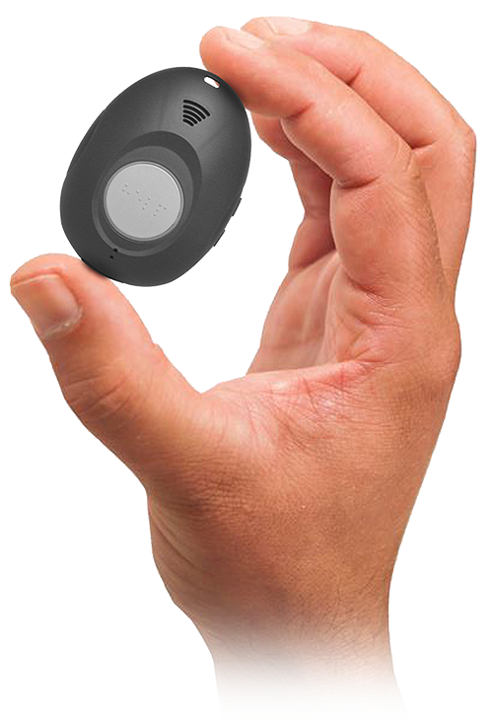
GeoPro Safety Wearable
Wearable: 2.5 x 1.8 x 0.67” and 1.5 oz
Loud audible alerts and voice: Crystal-clear audio quality.
One-Touch Button Operation: Tap to check-in or long-press to declare an SOS (monitored 24/7 by GEOS)
Waterproof: IPX7 (up to 3.3 ft for 30 min)
GPS Location – Location reporting with configurable intervals.
Battery Life - 72 hours (based on reporting location every 4 h); audible and visual low battery indicators
SOS alerting: With 24/7 monitoring service included
Fall Detection: With three sensitivity settings and built-in cancellation timer to prevent false alarms.
Check-in: Easy check-in, with persistent reminders until check-in is completed
Voice-Based Updates: For emergency, check-in, fall detection, battery, and cell signal status
Protected Phone Number - Only GEOS can call your protected number
Benefits: As a wearable safety device that works with GeoPro and features a single multi-function button for check-in and alerting, GeoPro Safety Wearable can be quickly deployed at a fraction of the cost associated with smartphone-based alternatives, and without the associated user training or privacy concerns.

Slide 49
Work Alone Monitoring App Comparison
Features | GeoPro | inReach Enterprise
Compatible devices | GeoPro Mobile App, Iridium Extreme, inReach SE, inReach Explorer, inReach SE+, inReach Explorer+, SHOUT Nano, SHOUT Nano Touch Screen and more | inReach, inReach SE, inReach Explorer, inReach SE+, inReach Explorer+
Configurable (maps, coordinate system, business rules) | Comprehensive | Partially
SOS alerts | ✓ | ✓
SOS monitoring | GEOS monitoring service or Directly by employer (GEOS as backup) | GEOS monitoring service or Directly by employer
Define/manage check-ins | ✓ | X
Missed check-in alert | ✓ | X
Track/locate | ✓ | ✓
Export data | ✓ | ✓
Waypoints | ✓ | ✓
Geofencing | ✓ | X

Slide 50
Q & A
Thank You!
Contact:
Email:
Phone:

